Slide 1
Introduction to Robotics CSE461
BRAC University

Slide 2
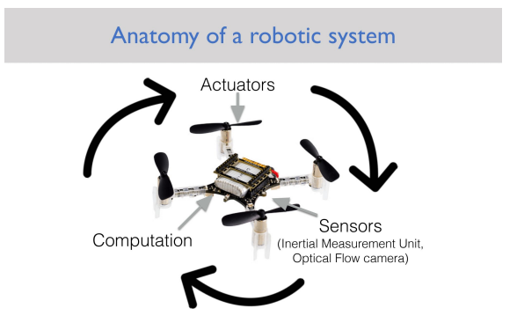

Slide 3
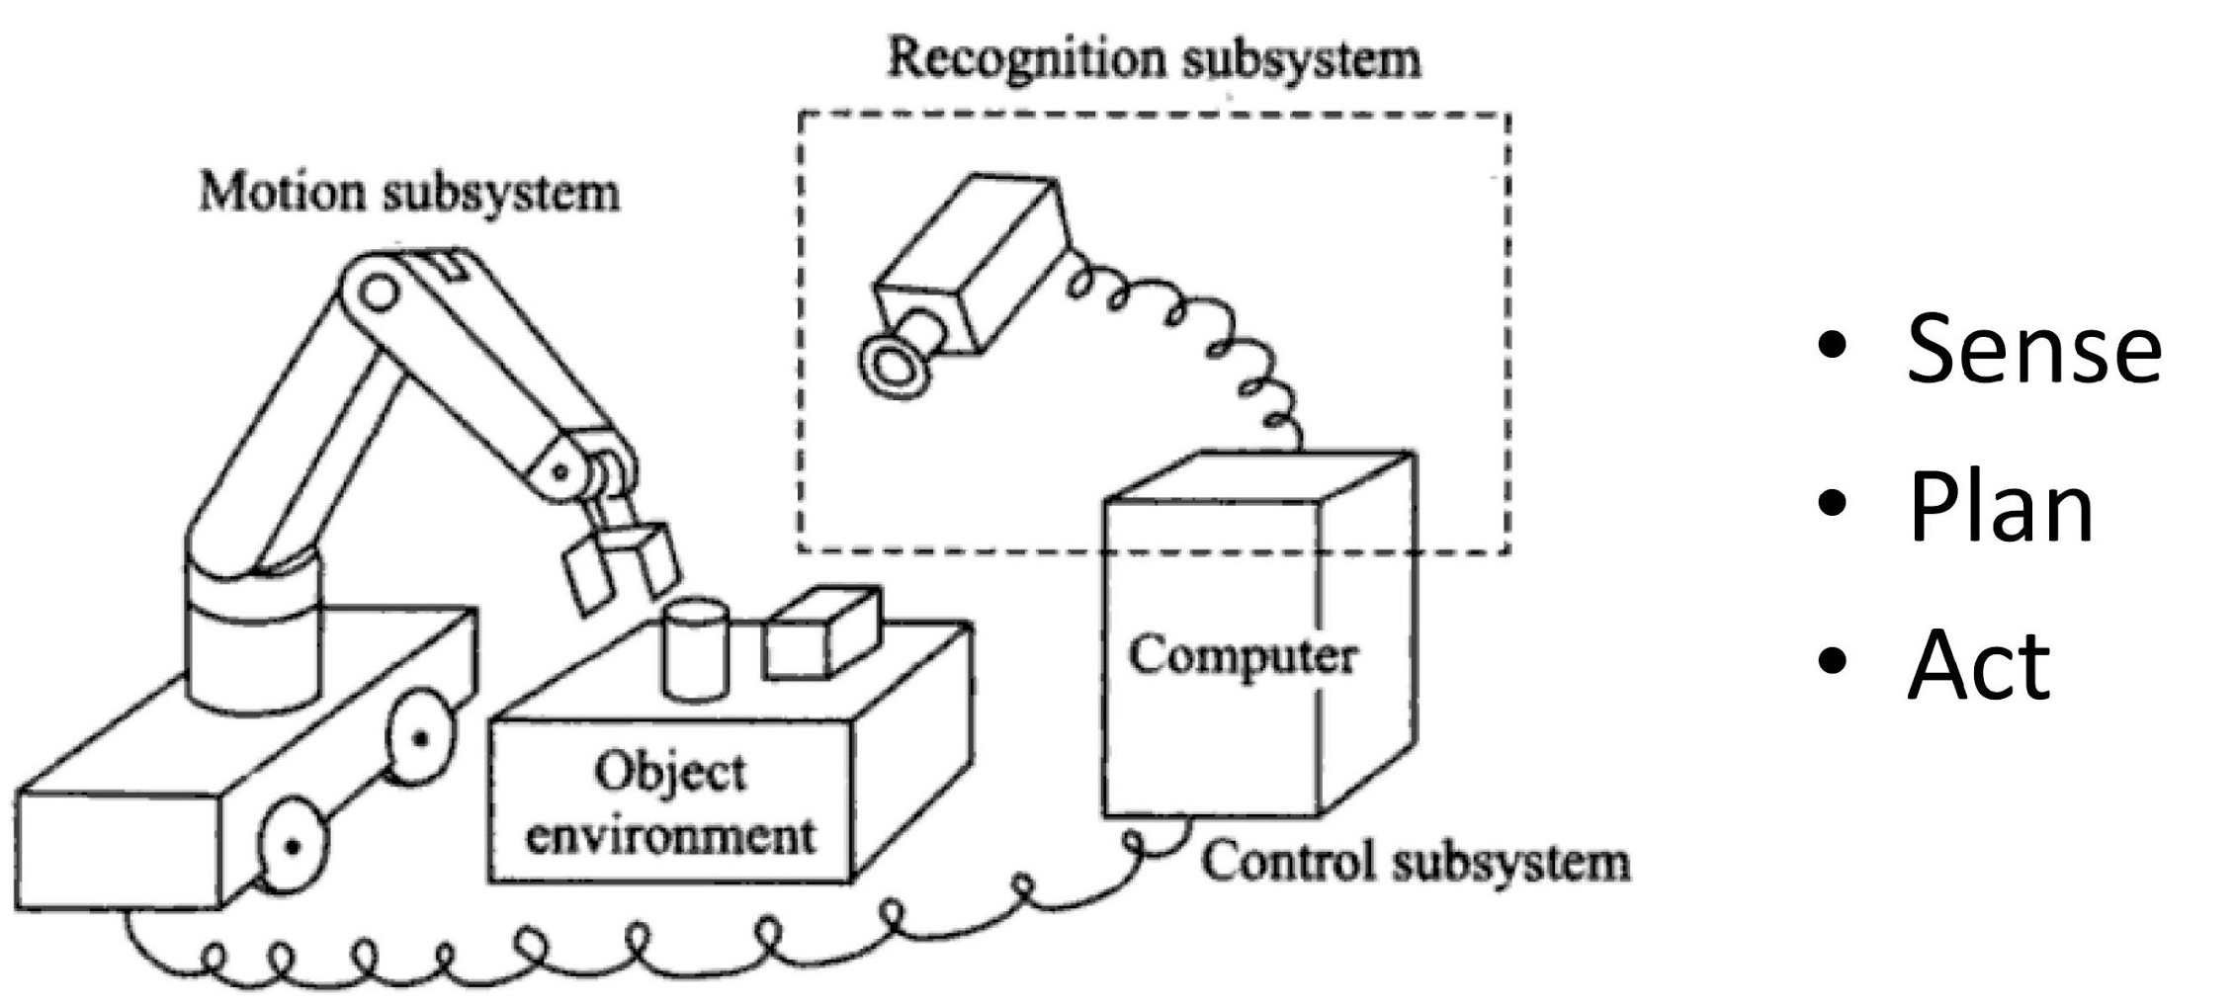
Three primitives of robotics

Slide 4
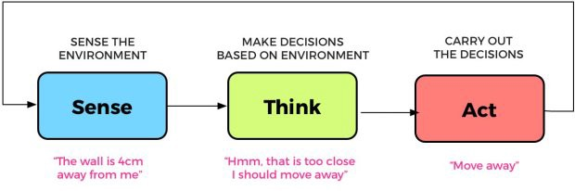
Example

Slide 5
AI Primitives within an Agent
SENSE
PLAN
ACT
LEARN

Slide 6
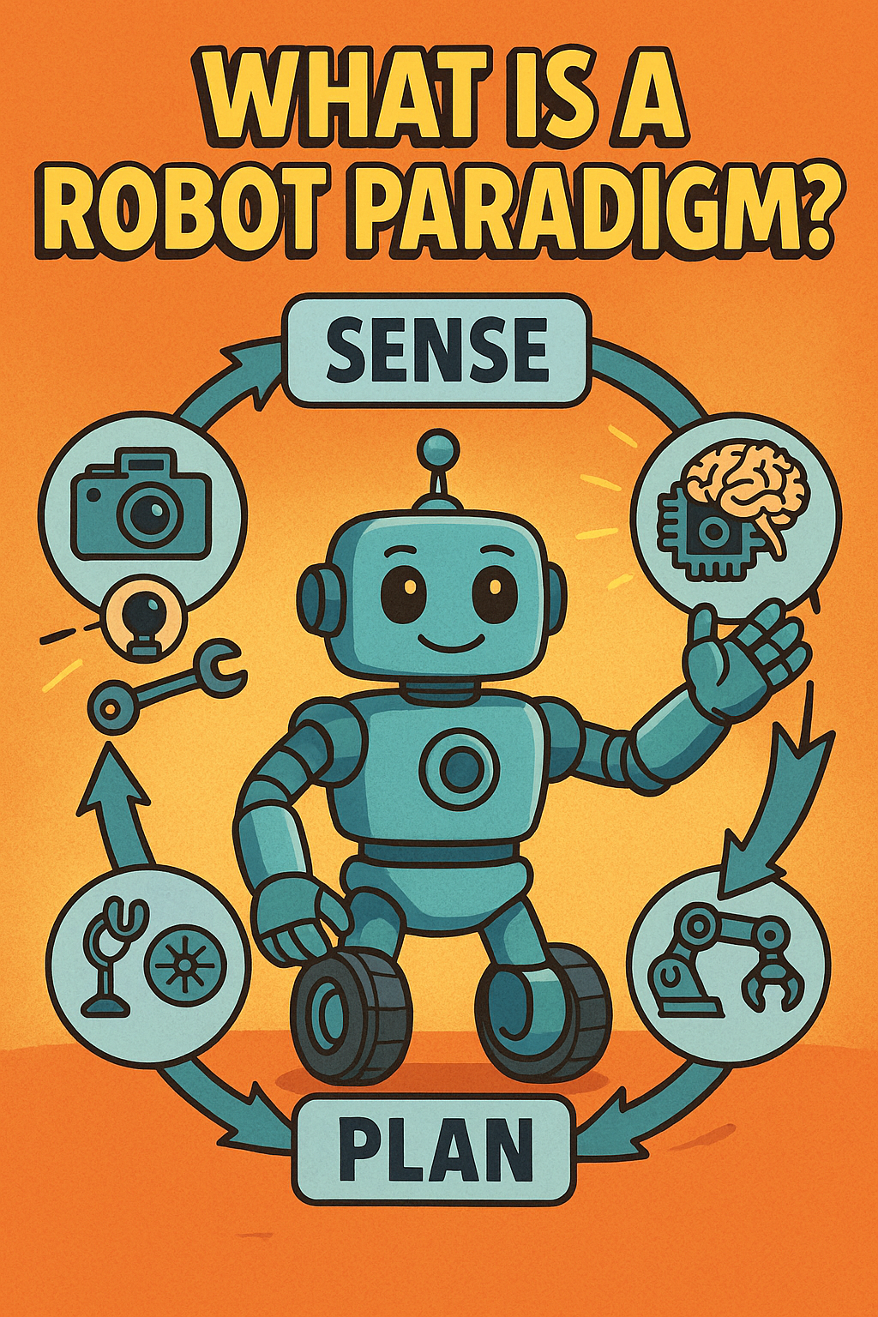

Slide 7
What is Paradigm
A paradigm is a set of ideas, methods, and assumptions that guide how problems are understood and solved in a particular discipline.
[Example] In Science: Newtonian Mechanics, Quantum Mechanics Each offers a different way to understand the physical world.
When a paradigm changes, the way we think and build systems changes with it.

Slide 8
Classical / Hierarchical Paradigm
Also called Deliberative Paradigm
Focus on automated reasoning and knowledge representation
STRIPS (Stanford Research Institute Problem Solver): Perfect world model, closed world assumption

Slide 9
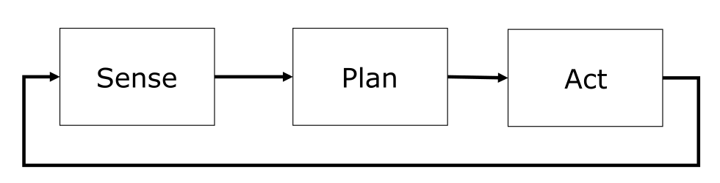
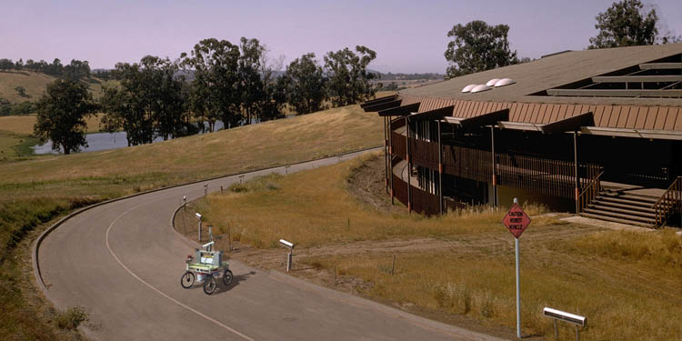
Classical / Hierarchical Paradigm
Developed by
Stanford AI Laboratory / CMU
(Hans Moravec)

Slide 10
Example
Take nine images of the environment, identify interesting points in one image, and use other images to obtain depth estimates.
Integrate information into global world model.
Correlate images with previous image set to estimate robot motion.
On basis of desired motion, estimated motion, and current estimate of environment, determine direction in which to move.
Execute the motion.

Slide 11
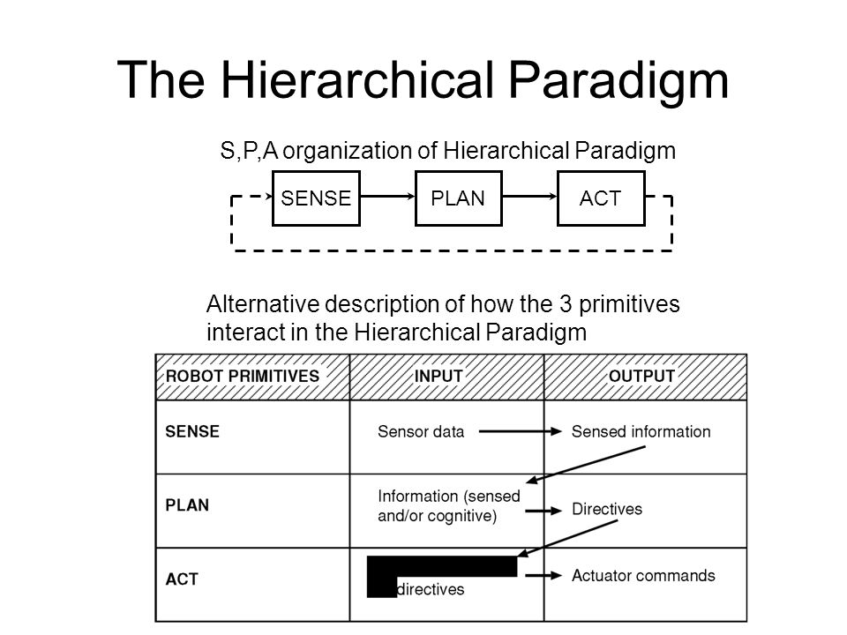

Slide 12
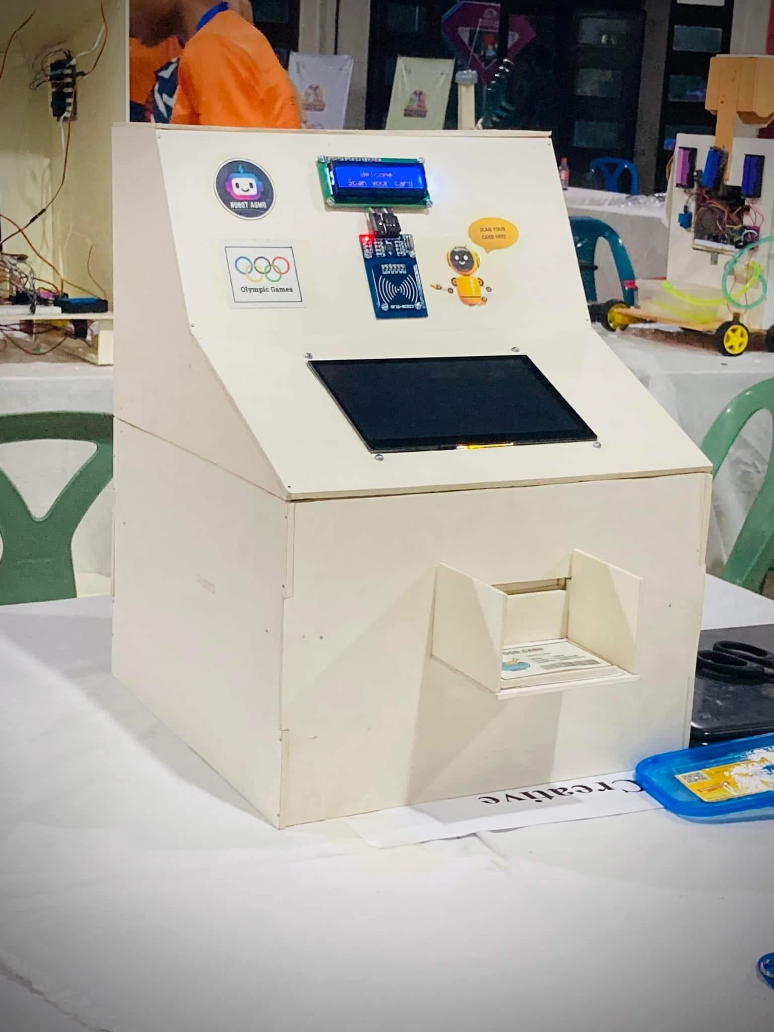

Slide 13


Slide 14
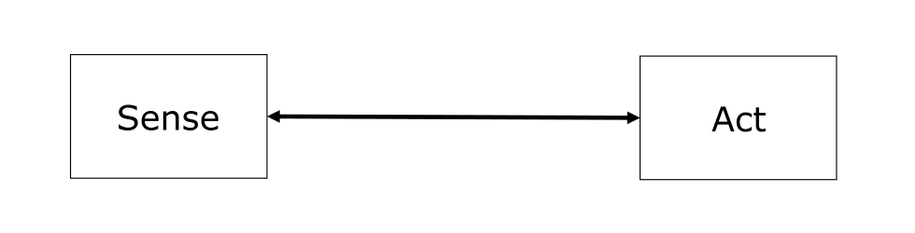
Reactive Paradigm
No models: The world is its own, best model
Easy successes, but also limitations
Investigate biological systems

Slide 15
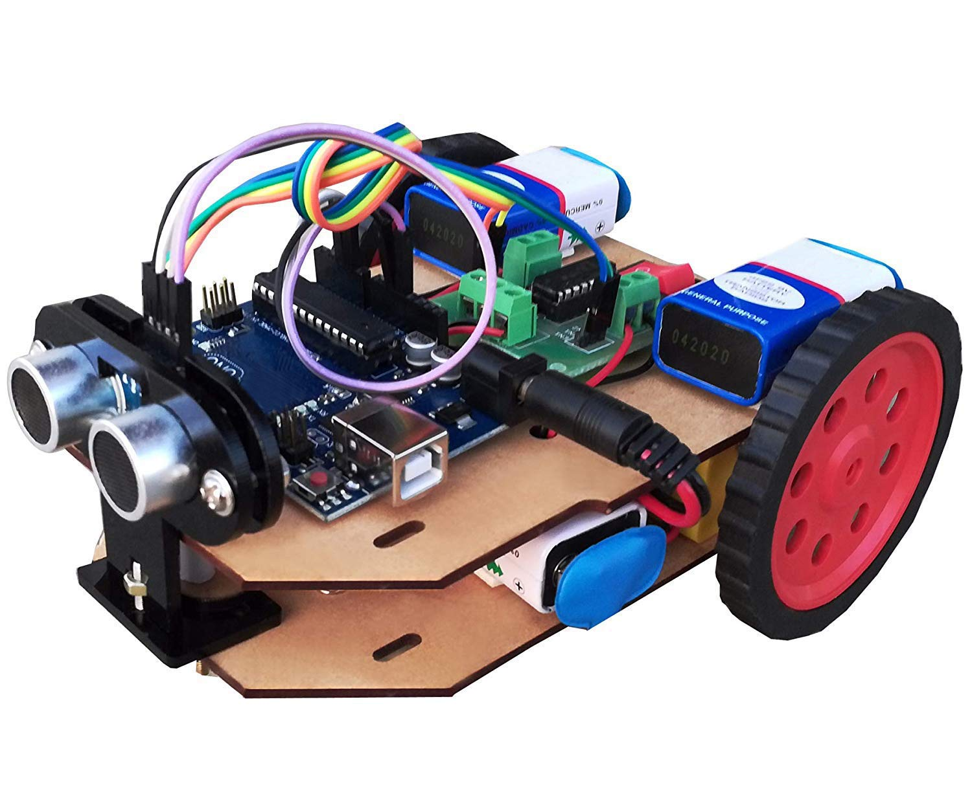
Characteristics of Reactive
Paradigm
No memory, controlled by what is happening in the world
Tight coupling between perception and action via behaviors
A direct mapping of sensory inputs to a pattern of motor actions that are then used to achieve a task.
Only local, behavior-specific sensing is permitted
There is no memory, no global path, no map of the room. The robot only looks at the current sensor values and immediately responds.
So the behavior becomes:
Wall appears → sensor triggers → robot turns
Path clears → robot moves forward
Another object appears → robot turns again

Slide 16
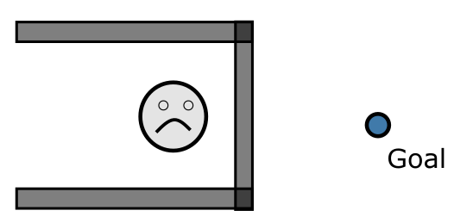
Limitations
Suffer from local minima
Backtracking
Random motion to escape local minimum

Slide 17
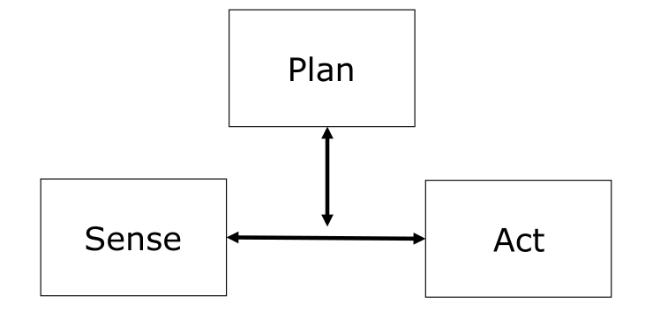
Hybrid Deliberative/Reactive
Paradigm
Combines advantages of previous paradigms:
World model used for planning
Closed loop, reactive control

Slide 18
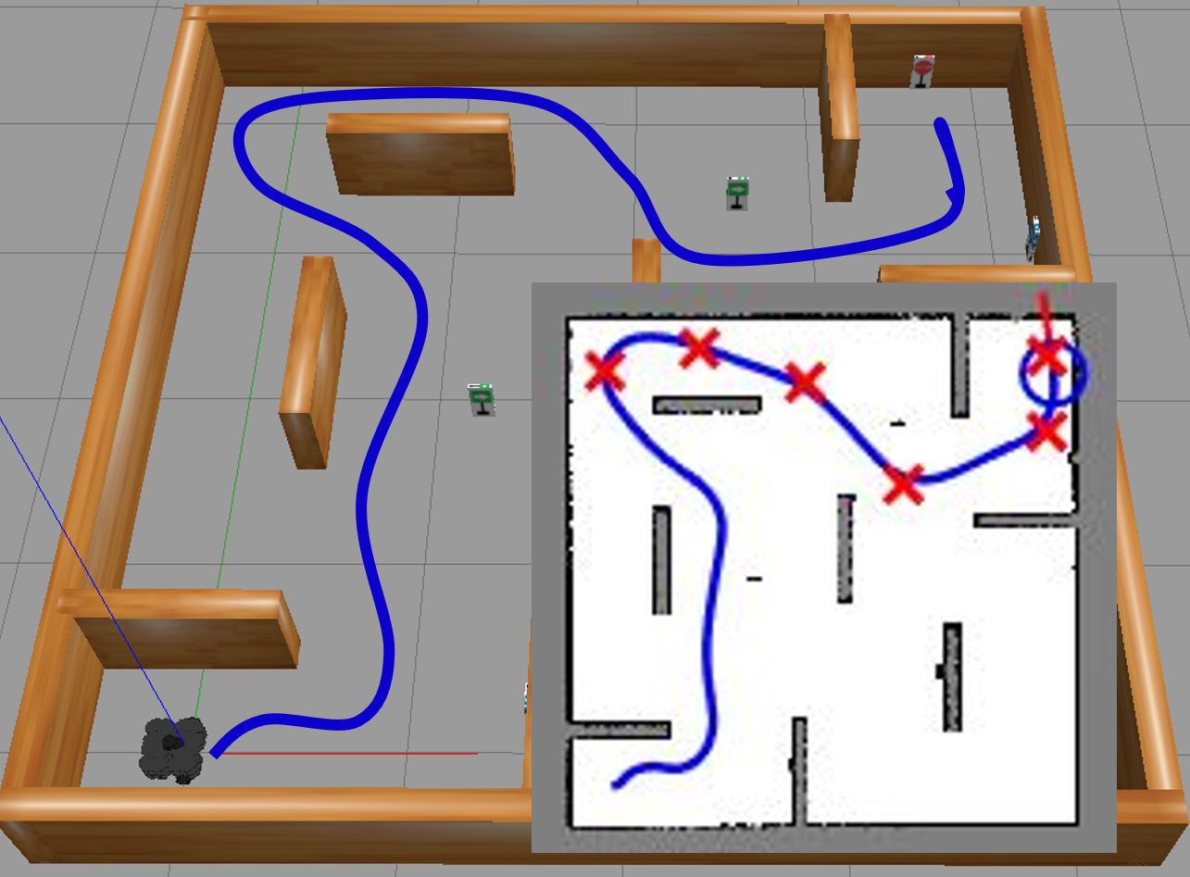
Example
How it works:
Reactive Layer
While moving, the robot continuously reads its sensors.
If a person suddenly walks in front of it, it does not stop and re-plan the whole route.
It immediately slows down, turns slightly, and avoids the person.
2. Planning Layer (Deliberative)
The robot has a map of the building.
It computes a path: Lab → Corridor → Stair → Office.
This layer answers where to go.
So the behavior looks like this:
Planner says: “Move toward the office.”
Sensors detect a chair blocking the way.
Reactive layer says: “Turn right now.”
After avoiding the chair, control goes back to the planner.
The robot continues toward the office.
This is why it is called hybrid:
Think globally, act locally.
The planner gives direction and purpose.
The reactive system handles real-time safety and obstacles.
Go from the lab to the office.

Slide 19
Local and Global Model
Reactive for Local control
Deliberative for Global control
However; Robot behavioral management requires to know its current mission, state and environment beside path-planning, map-making, monitoring etc. So, both local and global models are required to be considered for a robot performance.

Slide 20
ROBOTIC PARADIGMS
Hierarchical/deliberative paradigm
The reactive paradigm
Hybrid deliberative/reactive paradigm
A fourth category, not always listed, is “Behavior-Based Control”
https://www.youtube.com/watch?v=dnidauuaWYU

Slide 21
Comparison of Robotic Paradigms
Aspect | Hierarchical | Reactive | Hybrid
Core Philosophy | Think first, then act | Act immediately based on sensors | Think globally, act locally
S-P-A Coupling | Long planning phase | Direct mapping | Planner + Reactive loops
World Model | Explicit global model | No world model | Global + local models
Memory | Required | None | Partial (task & map memory)
Planning | Centralized | No planning | High-level planning only
Reaction to dynamic changes | Very poor | Excellent | Excellent
Speed | Slow | Very fast | Balanced
Robustness to noise | Low | Medium | High
Local Obstacle Avoidance | Weak | Strong | Strong
Goal-Driven Behavior | Strong | Weak | Strong
Failure Mode | Freezes | Gets stuck in local minima | Graceful degradation
Real World Usability | Low | Medium | High
Examples | Early stage robots | Wall following robots | Autonomous cars

Slide 22
Let’s know, How robots work?

Slide 23
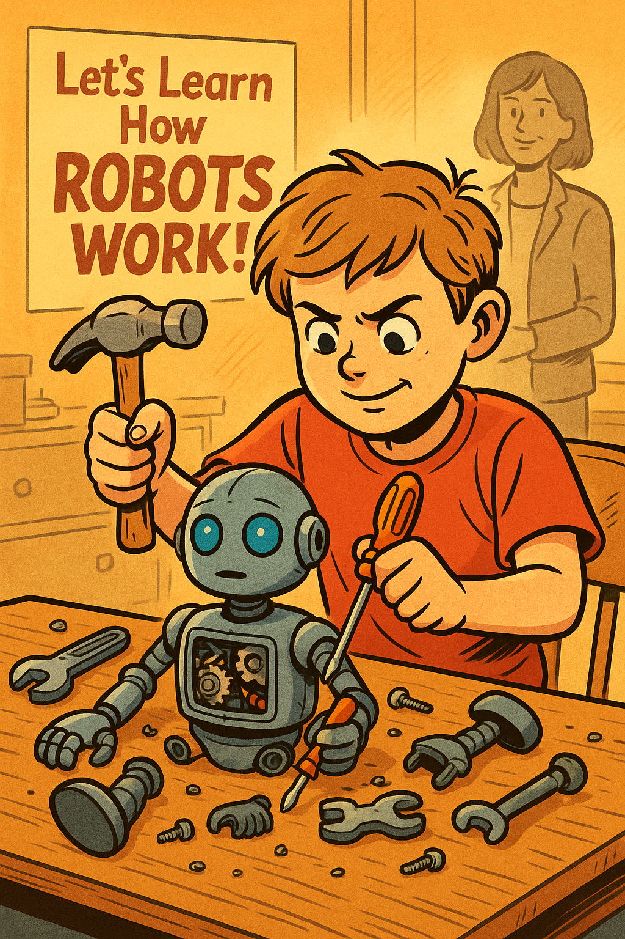

Slide 24
Sub-Systems
Sense/Perception/ Recognition
Plan/Control
Act/Motor Action/Motion
Power
Communication

Slide 25
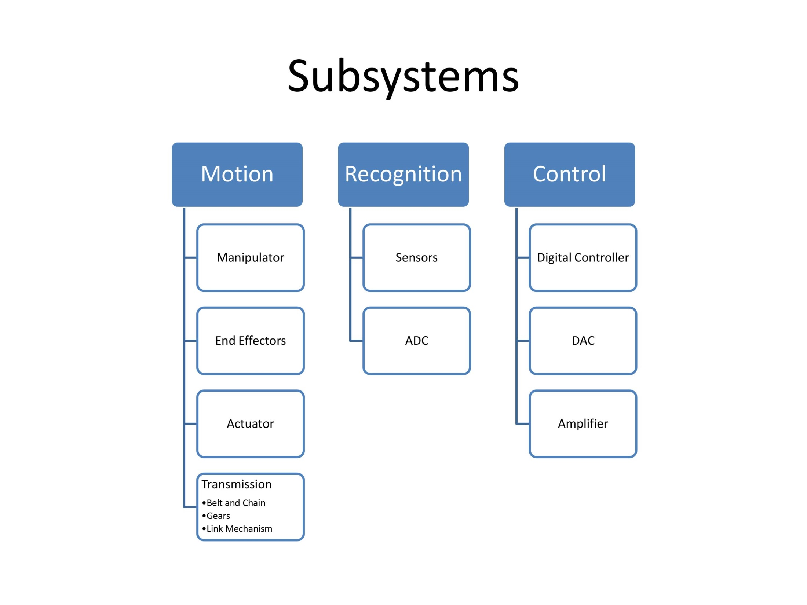

Slide 26
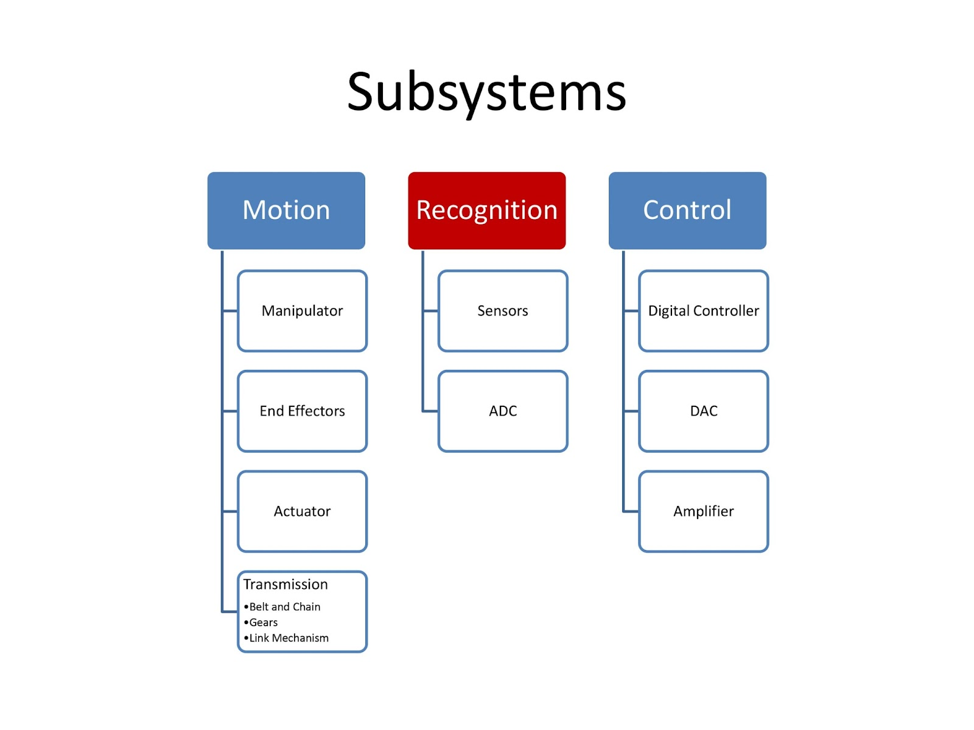

Slide 27
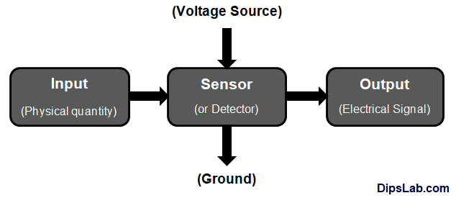
Sensor
A sensor is a device that detects or measures physical, chemical, or biological properties of the environment or a system and converts them into a signal that can be processed or analyzed.

Slide 28
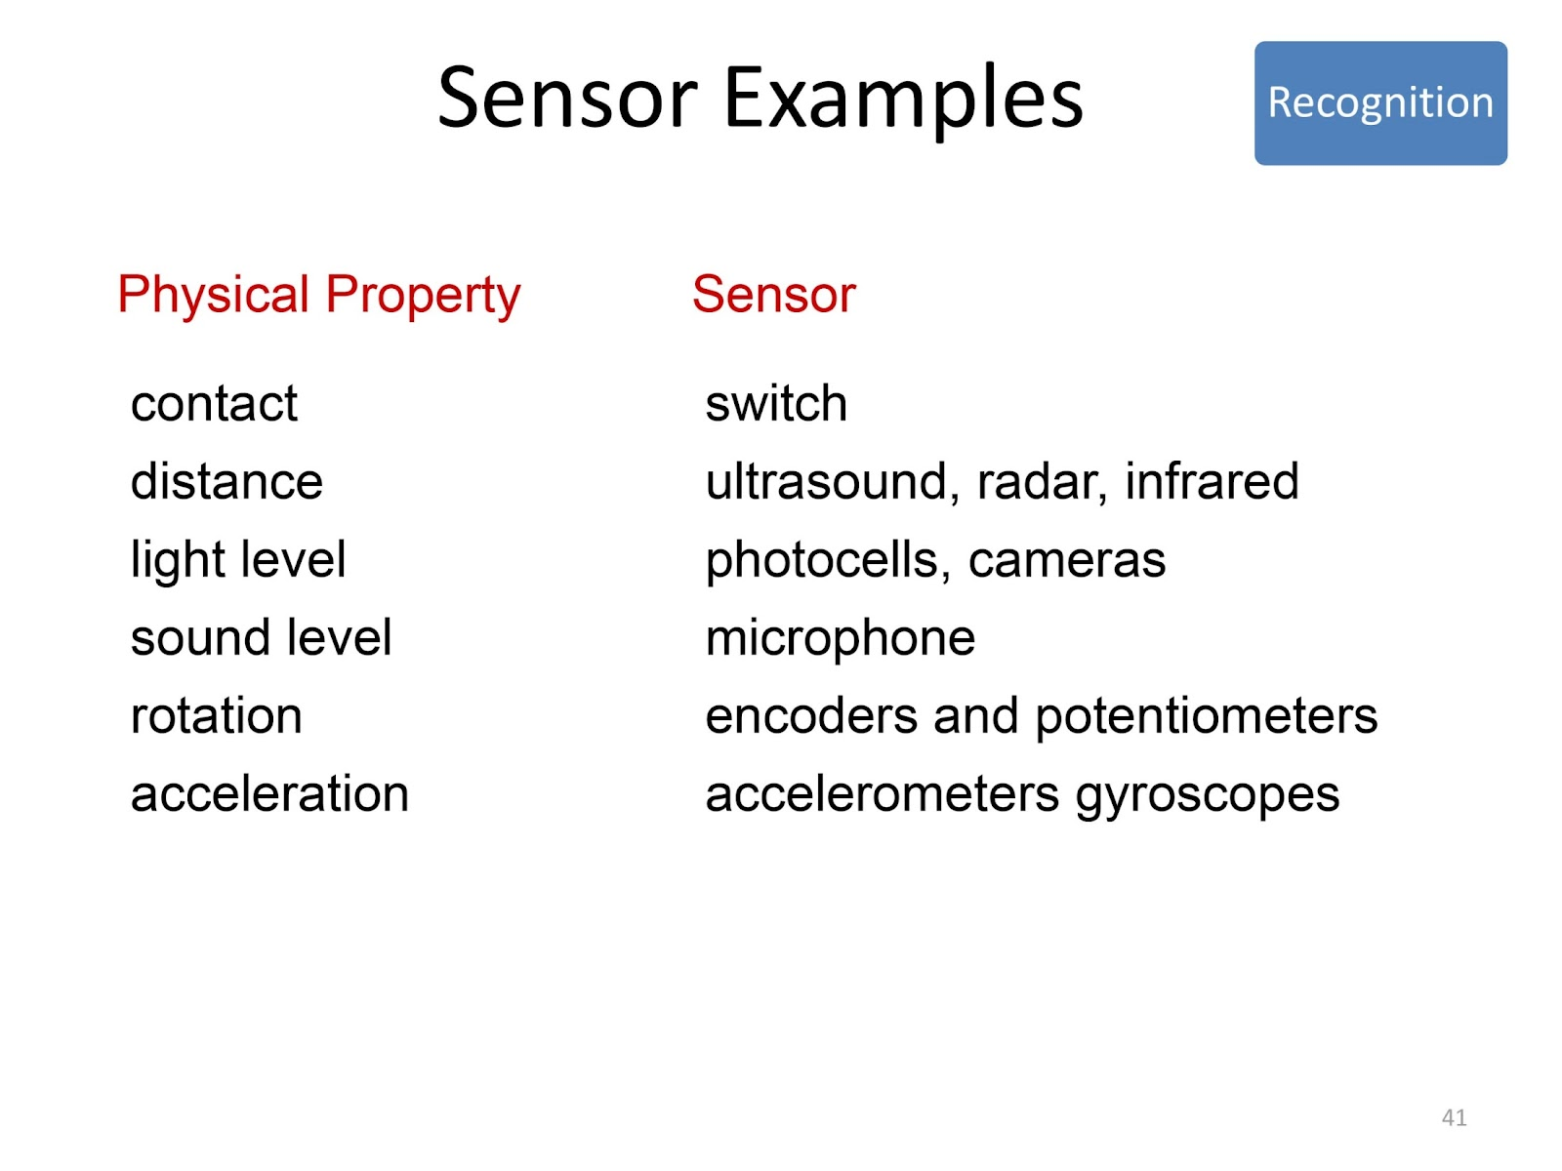

Slide 29
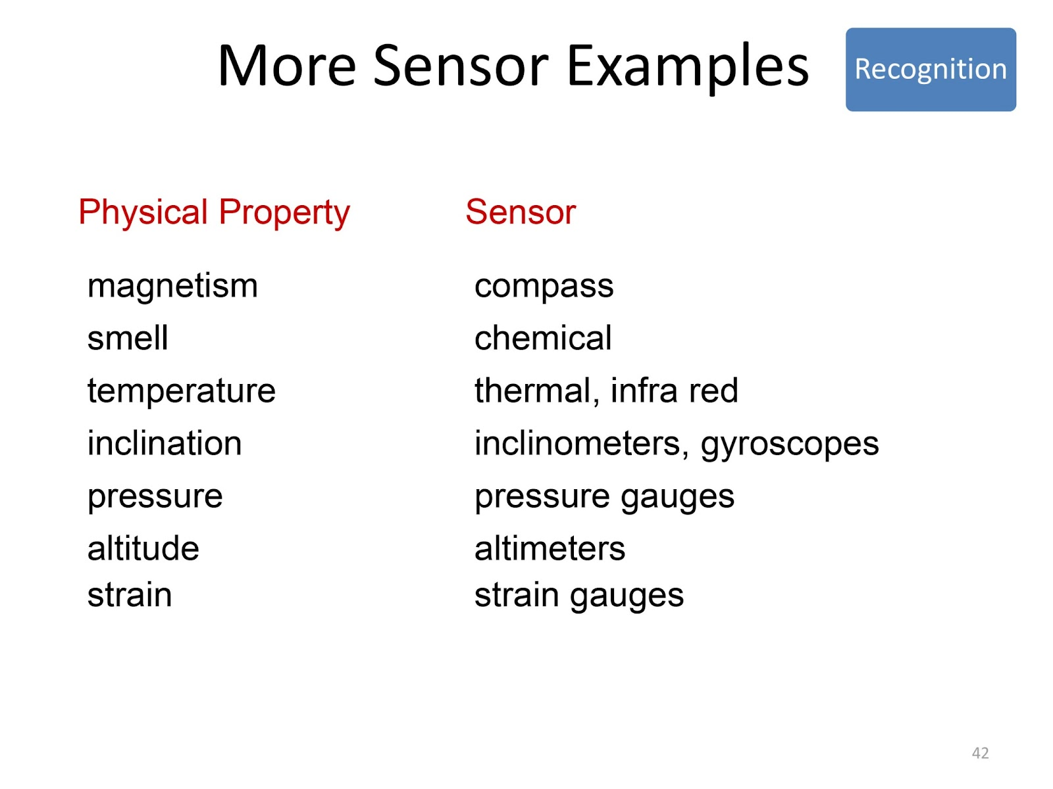

Slide 30
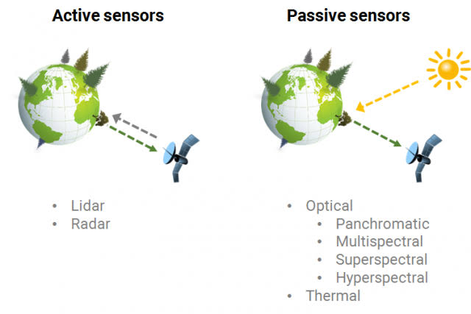

Slide 31
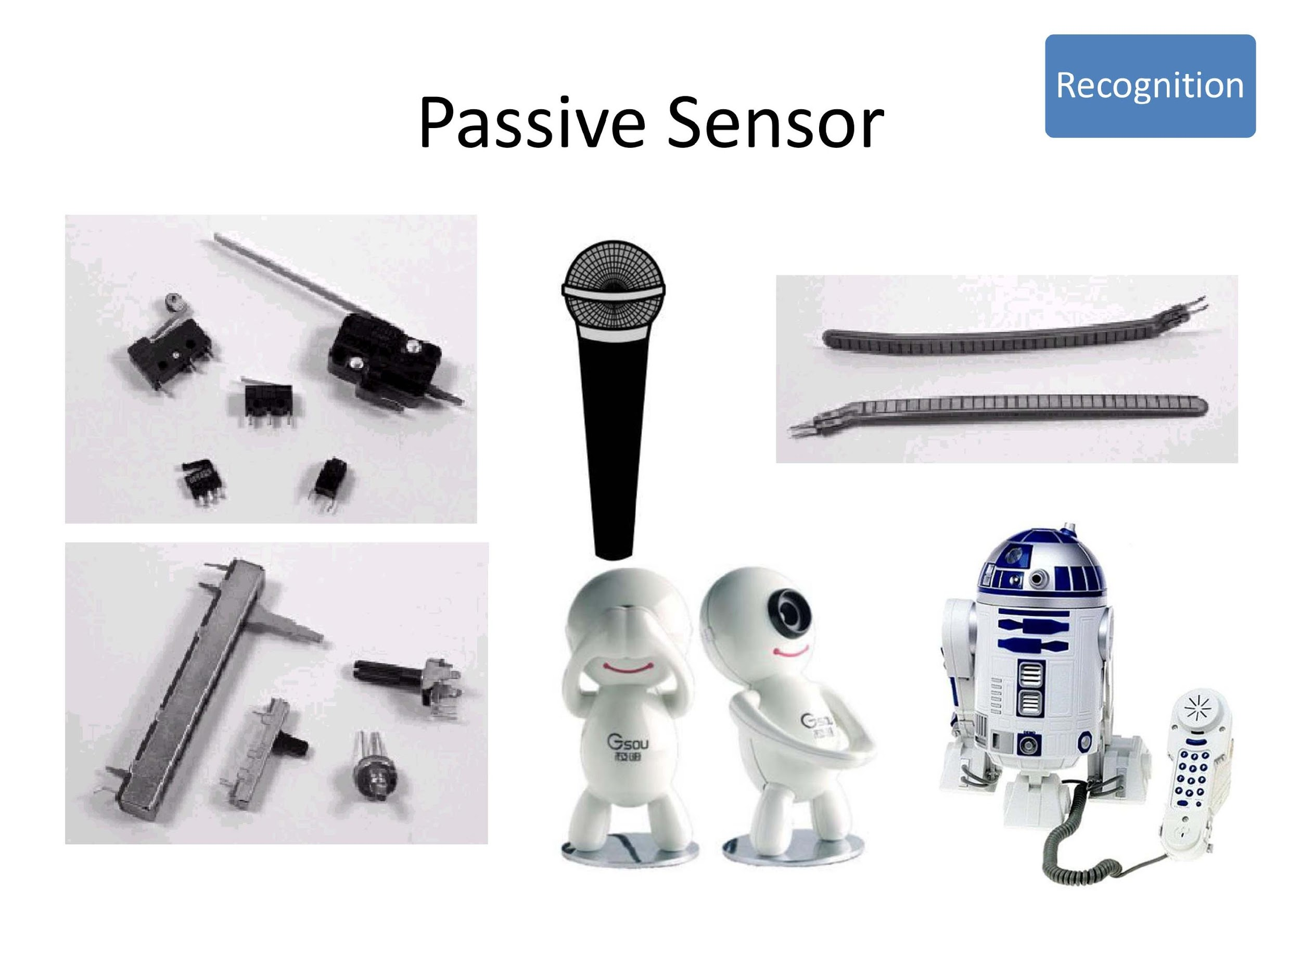

Slide 32
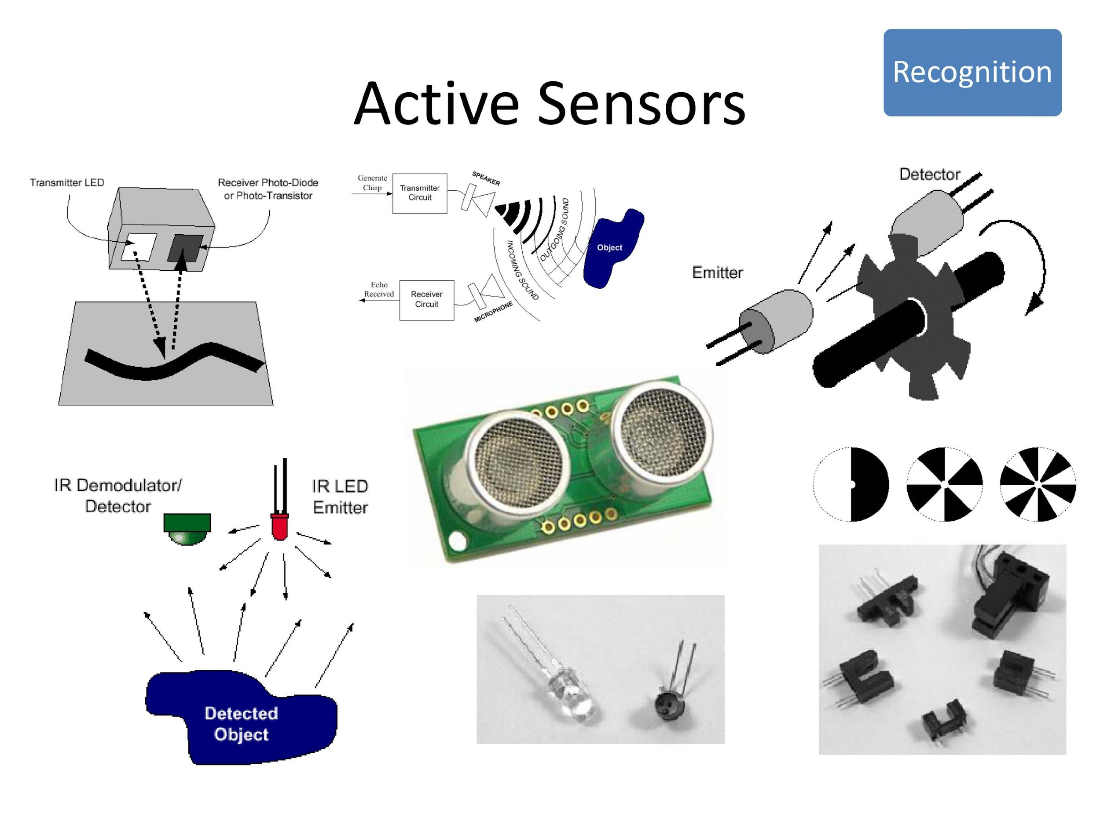

Slide 33
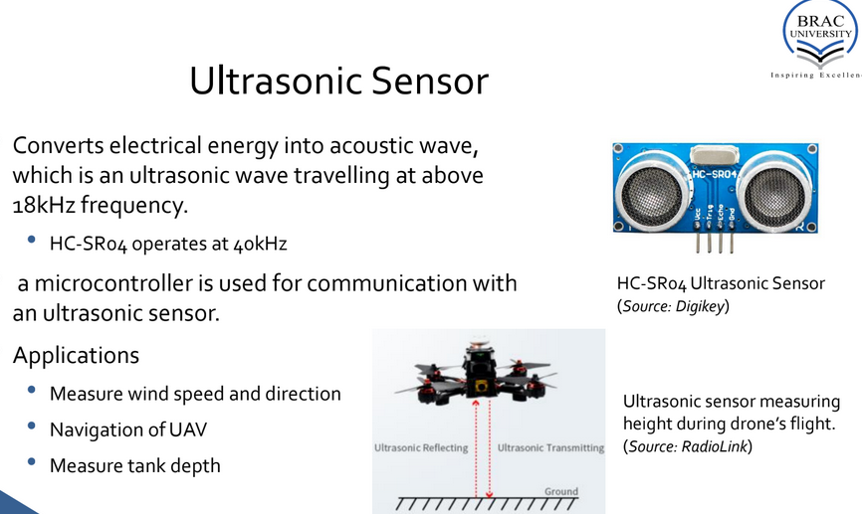

Slide 34
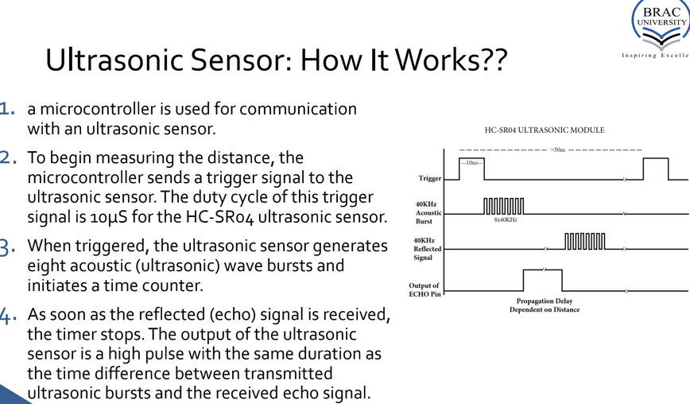

Slide 35
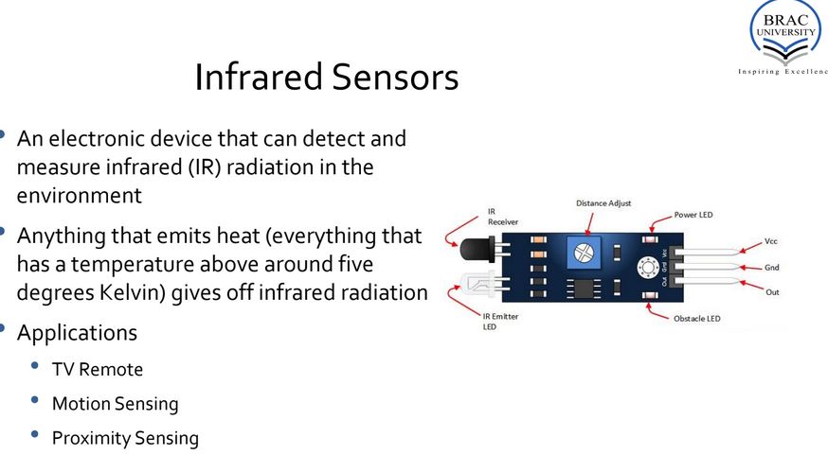

Slide 36
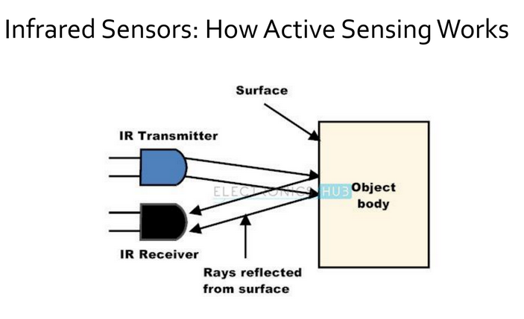

Slide 37
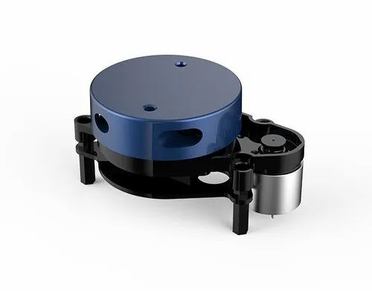
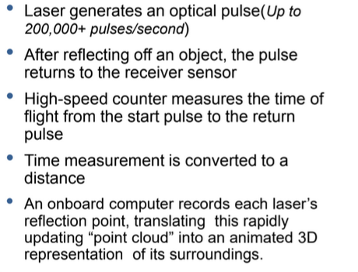
Lidar

Slide 38
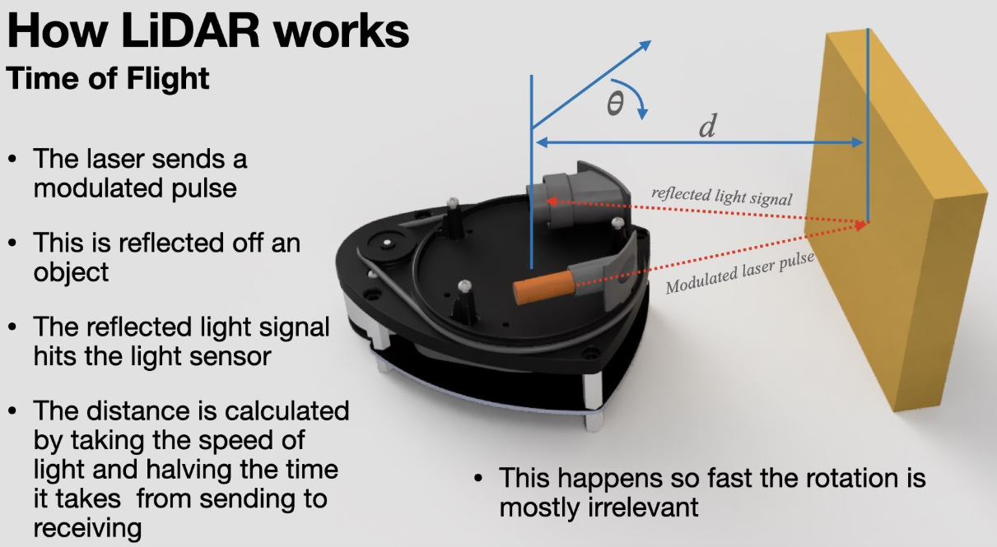

Slide 39
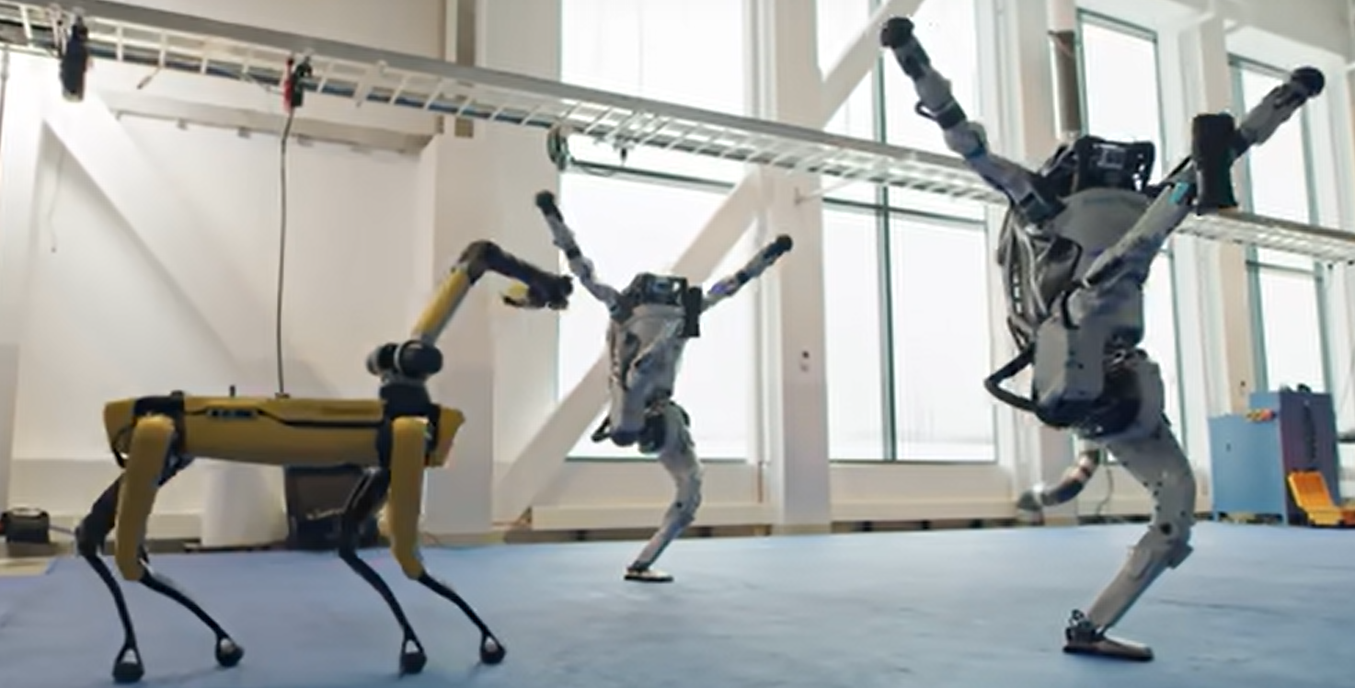
Let’s talk about a dream !
https://www.youtube.com/watch?v=fn3KWM1kuAw

Slide 40
Thank You

